Slide 1
Java Database Connectivity

Slide 2
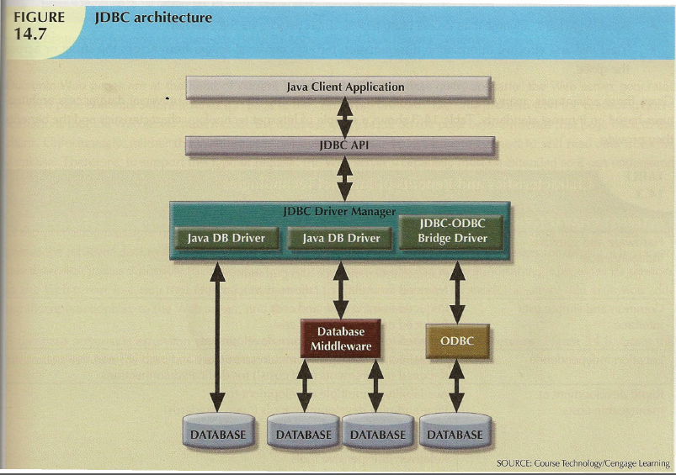
Database Connectivity
Image Copyright 2013 Cengage Technology, Cengage Learning.

Slide 3
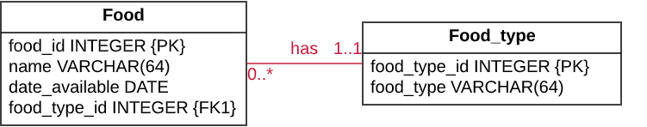
Simple Food Schema

Slide 4
Creating Food Tables in JDBC
public class CreateFoodTables {
public static void main(String[] args) {
String connectionUrl =
"jdbc:sqlserver://localhost\\SQLEXPRESS:1433;"
+ "database=MyDB;"
+ "user=MyUser;"
+ "password=ABC123;"
+ "encrypt=true;"
+ "trustServerCertificate=true;"
+ "loginTimeout=30;";
try (Connection connection = DriverManager.getConnection(connectionUrl);
Statement statement1 = connection.createStatement();
Statement statement2 = connection.createStatement();) {
String sql =
"CREATE TABLE Food_type (" +
"food_type_id INTEGER NOT NULL PRIMARY KEY," +
"food_type VARCHAR(64) NOT NULL)";
statement1.executeUpdate(sql);
sql =
"CREATE TABLE Food (" +
"food_id INTEGER NOT NULL PRIMARY KEY," +
"name VARCHAR(64) NOT NULL," +
"date_available DATE NOT NULL," +
"food_type_id INTEGER NOT NULL REFERENCES Food_type(food_type_id))";
statement2.executeUpdate(sql);
}
catch (SQLException e) {
e.printStackTrace();
}
}
}
Notes:
The executeUpdate() method is used to execute DDL (not just an update).
Note that it is quite uncommon to create tables in an application.
This is typically performed with a SQL client before the application runs the first time.
Tables need to be created once and then they exist indefinitely until deleted.

Slide 5
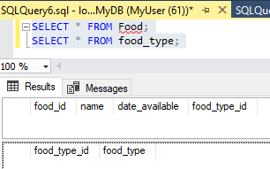
Food Tables After Creation

Slide 6
Inserting Into Food Tables in JDBC
public class InsertIntoFoodTables {
public static void main(String[] args) {
String connectionUrl =
"jdbc:sqlserver://localhost\\SQLEXPRESS:1433;"
+ "database=MyDB;"
+ "user=MyUser;"
+ "password=ABC123;"
+ "encrypt=true;"
+ "trustServerCertificate=true;"
+ "loginTimeout=30;";
String food_type_sql = "INSERT INTO Food_type (food_type_id, food_type) Values (?, ?)";
String food_sql
= "INSERT INTO Food (food_id, name, date_available, food_type_id) Values (?, ?, ?, ?)";
try (Connection connection = DriverManager.getConnection(connectionUrl);
PreparedStatement foodTypeStatement = connection.prepareStatement(food_type_sql);
PreparedStatement foodStatement = connection.prepareStatement(food_sql);) {
foodTypeStatement.setInt(1, 1); foodTypeStatement.setString(2,"Entree");
foodTypeStatement.executeUpdate();
foodTypeStatement.setInt(1, 2); foodTypeStatement.setString(2,"Dessert");
foodTypeStatement.executeUpdate();
foodStatement.setInt(1, 101); foodStatement.setString(2, "Pizza");
foodStatement.setDate(3, Date.valueOf("2020-02-19")); foodStatement.setInt(4, 1);
foodStatement.executeUpdate();
foodStatement.setInt(1, 102); foodStatement.setString(2, "Ice Cream");
foodStatement.setDate(3, Date.valueOf("2020-03-05")); foodStatement.setInt(4, 2);
foodStatement.executeUpdate();
}
catch (SQLException e) {
e.printStackTrace();
}
}
}
Notes:
For SQL statements that are the same except for the values, such as the case with these inserts, use the PreparedStatement.
This allows the database to recognize these as the same query and perform more efficiently. It’s also more efficient in Java.
Then, set the parameters using the setXYZ methods such as setInt, setString, setDate, and so forth.
Use executeUpdate for inserts also.

Slide 7
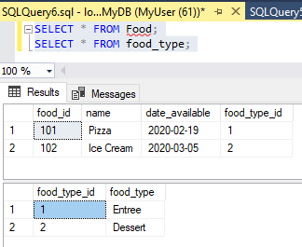
Food Tables After Insertion

Slide 8
Selecting from Food Tables in JDBC
public class SelectFoodTables {
public static void main(String[] args) {
String connectionUrl =
"jdbc:sqlserver://localhost\\SQLEXPRESS:1433;"
+ "database=MyDB;"
+ "user=MyUser;"
+ "password=ABC123;"
+ "encrypt=true;"
+ "trustServerCertificate=true;"
+ "loginTimeout=30;";
try (Connection connection = DriverManager.getConnection(connectionUrl);
Statement statement = connection.createStatement();) {
String sql =
"SELECT name, date_available, food_type " +
"FROM food " +
"JOIN food_type ON food.food_type_id = food_type.food_type_id";
ResultSet results = statement.executeQuery(sql);
while (results.next()) {
String name = results.getString(1);
Date date_available = results.getDate(2);
String food_type = results.getString(3);
System.out.println(name + " (" + food_type + ") is available on " + date_available + ".");
}
}
catch (SQLException e) {
e.printStackTrace();
}
}
}
Notes:
Use the executeQuery method to execute a query that returns results.
It returns a resultsset.
Iterate through the resultset with the next() function.
Use the getXYZ methods such as getString, getDate, and so on to get each column (specifying the column ordinal).
Then you have your data!

Slide 9
Selecting from Food Output
Output
Pizza (Entree) is available on 2020-02-19.
Ice Cream (Dessert) is available on 2020-03-05.
Notes:
You can print in the simple case, or use the data just like any other data at this point.

Slide 10
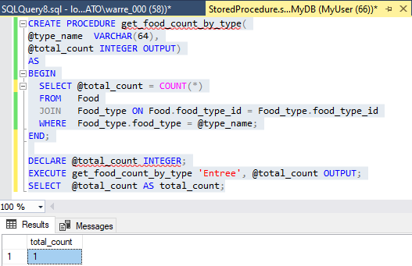
Calling Food Stored Procedure in SSMS

Slide 11
Calling Food Stored Procedure in JDBC
public class FoodTablesStoredProcedure {
public static void main(String[] args) {
String connectionUrl =
"jdbc:sqlserver://localhost\\SQLEXPRESS:1433;"
+ "database=MyDB;"
+ "user=MyUser;"
+ "password=ABC123;"
+ "encrypt=true;"
+ "trustServerCertificate=true;"
+ "loginTimeout=30;";
String callable_sql = "{call get_food_count_by_type(?, ?)}";
try (Connection connection = DriverManager.getConnection(connectionUrl);
CallableStatement callableStatement = connection.prepareCall(callable_sql);) {
callableStatement.setString(1, "Entree");
callableStatement.registerOutParameter(2, Types.INTEGER);
callableStatement.execute();
System.out.println("The total number of entrees is " + callableStatement.getInt(2));
}
catch (SQLException e) {
e.printStackTrace();
}
}
}
Output
The total number of entrees is 1
Notes:
Use the prepareCall method to create a callable statement.
Set the parameters using the setXYZ methods.
Register any output paramaters with the “registerOutputParameter” method.
Use the execute() method to execute the procedure.
Use the getXYZ methods to get the output parameters (similar to using the getXYZ methods in ResultSet except there’s only one set).

Slide 12
Object-Relational Mapping
Nowadays we commonly (but not exclusively) rely on object-relational mapping (ORM) frameworks, which create a set of Java objects mirroring the database, and handle reading and writing from the database from/into these objects.
ORM frameworks use JDBC, but the users of the ORM just use the methods provided by the ORM.
Hibernate is the most popular ORM for Java and has been around a long time.
Others included Apache Open JPA and iBATIS.

Slide 13

End

